Slide 1

GitHub
Carmelo Scribano
Ali Lezzeik
Because sharing is caring<3

Slide 2

But what is Git you may ask?
Git is a version control software used for documenting and updating sets of files. It is usually use for software development for projects that multiple people work on.
Git is a free and open-source distributed software developed by Linus Torvalds,
The Man, the Myth, the Legend himself →
This Photo by Unknown Author is licensed under CC BY-SA

Slide 3

So, then what is GitHub??!
GitHub is not Git (duh), it is a service that uses the version-control software in a user-friendly GUI to collaborate work. It is used by millions and was developed my Microsoft.
Basically, this software is a good way to make sure you or anyone on the team does not screw up the big project you are all working on.

Slide 4
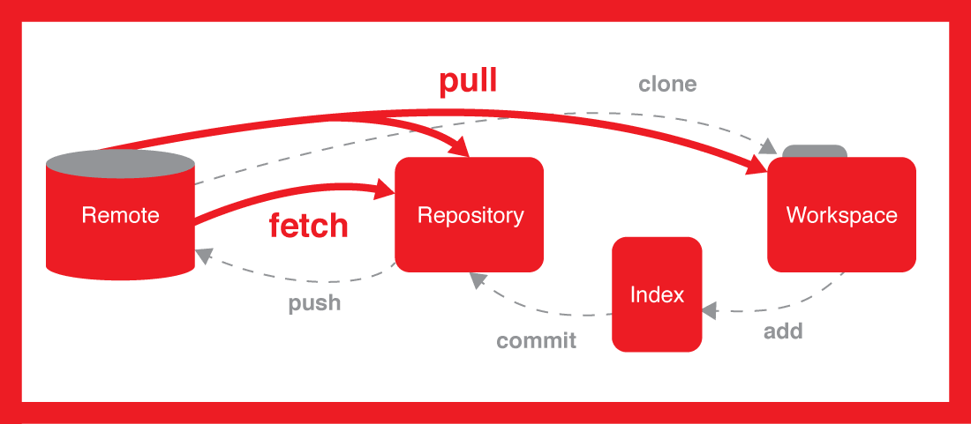
But how do I use GitHub?!
You can use GitHub in a terminal such as in a Linux machine or you could use an application such as GitHub Desktop to do those same commands but in a more visual friendly way.
Those are the 5 basic commands that you will need to know to become an absolute Git Master:
Git Clone
Git Fetch
Git Pull
Git Commit
Git Push

Slide 5
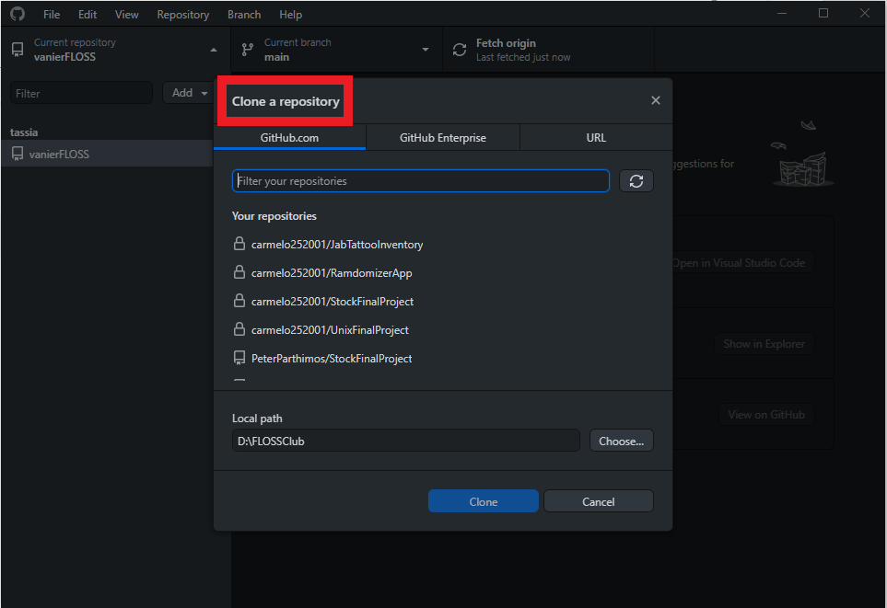
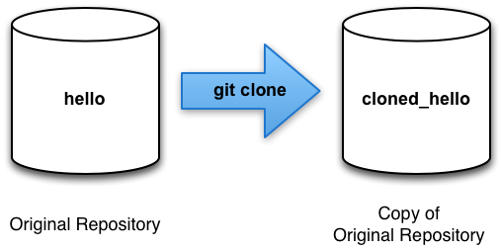
Git Clone
Used to make a copy of a repo into a new directory. Useful to copy code.

Slide 6
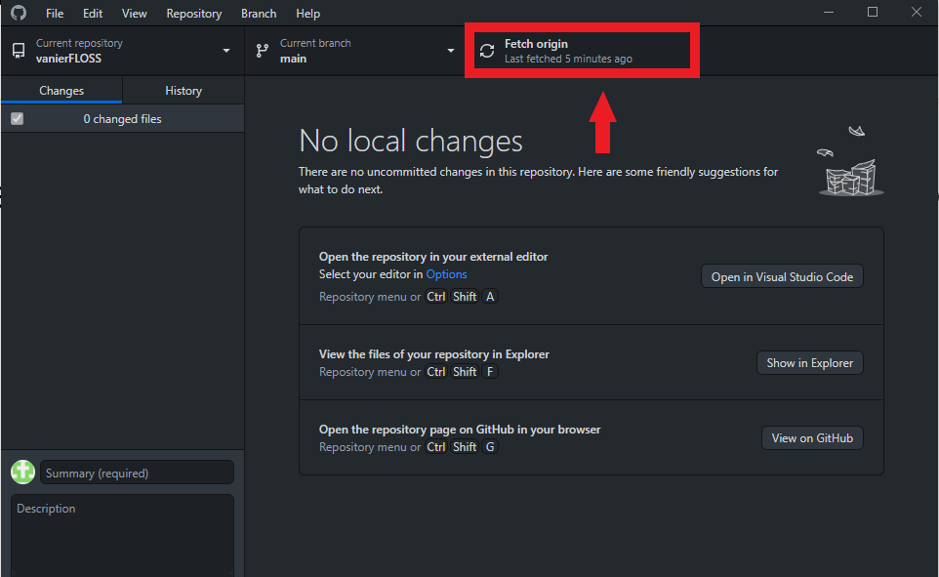
Git Fetch
Downloads data from the remote repository but does not integrate. Basically, a way to see any changes. Cannot modify anything, a safe command to use.

Slide 7
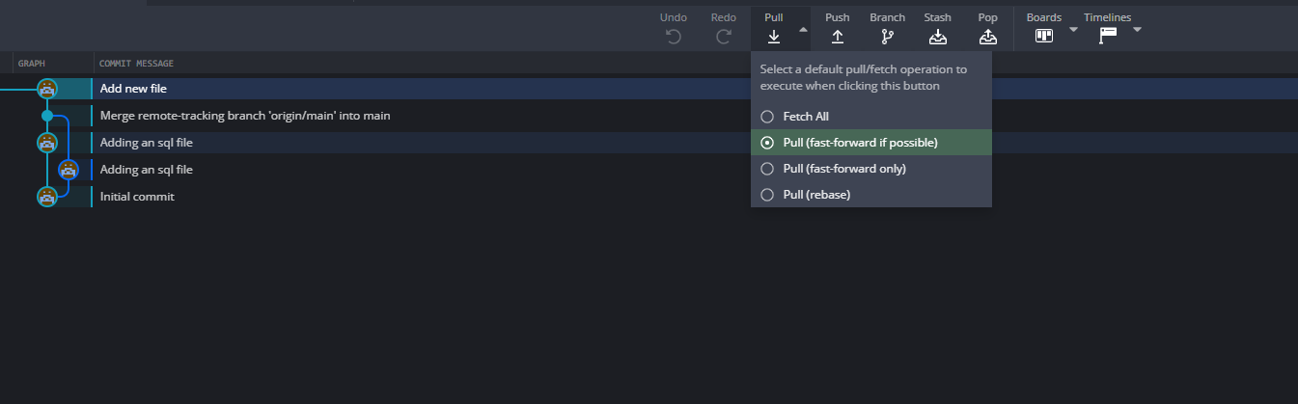
Git Pull
Get all the changes that you do not have on your local machine from the remote repository. Should do this before working on any files.

Slide 8
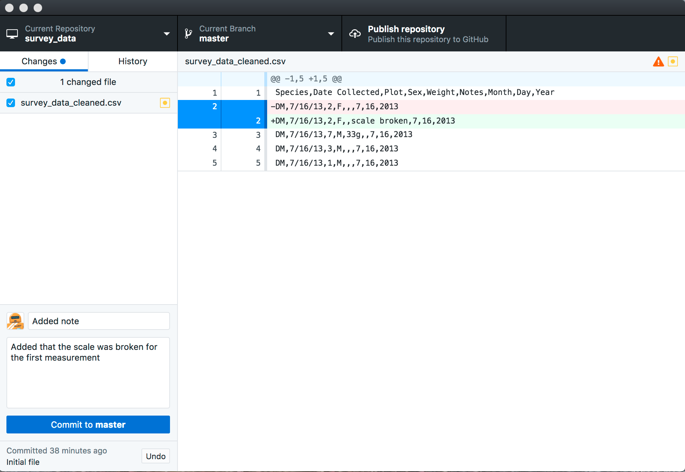
Git Commit
Commit changes to the head but not yet to the global repository, Basically like a local save.

Slide 9
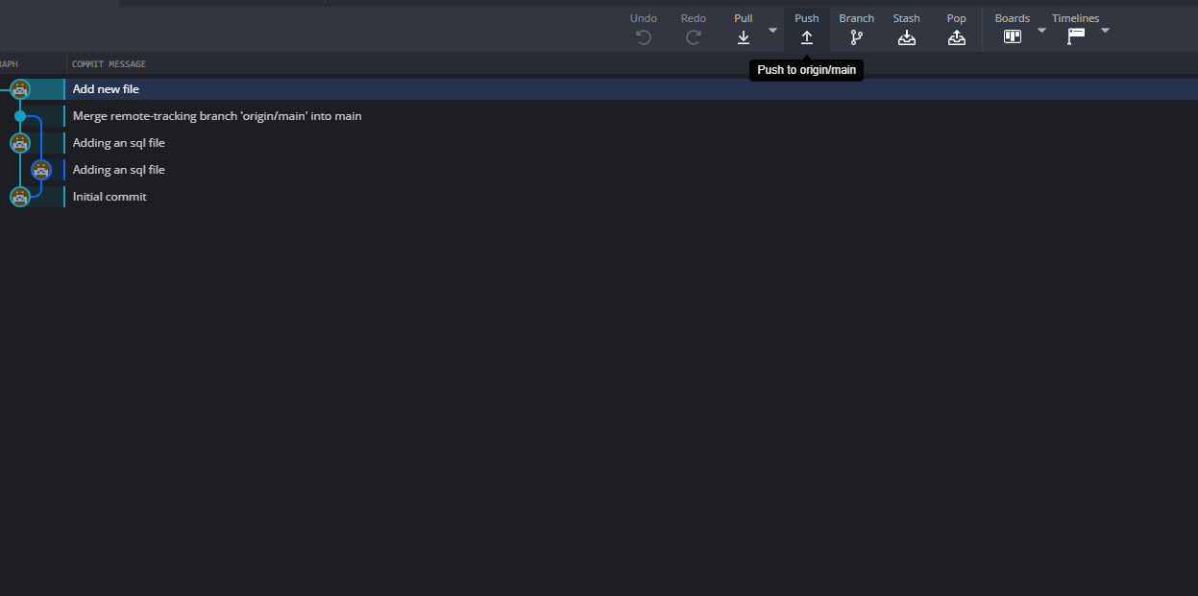
Git Push
The Big Command. Pushes all the changes that you have done to the actual remote repository where all collaborators will see. Don't make any mistakes.

Slide 10


Muito Obrigado!
Questions?
This work is licensed under the Creative Commons Attribution-ShareAlike 4.0 International License. To view a copy of this license, visit https://creativecommons.org/licenses/by-sa/4.0/.

